Slide 1
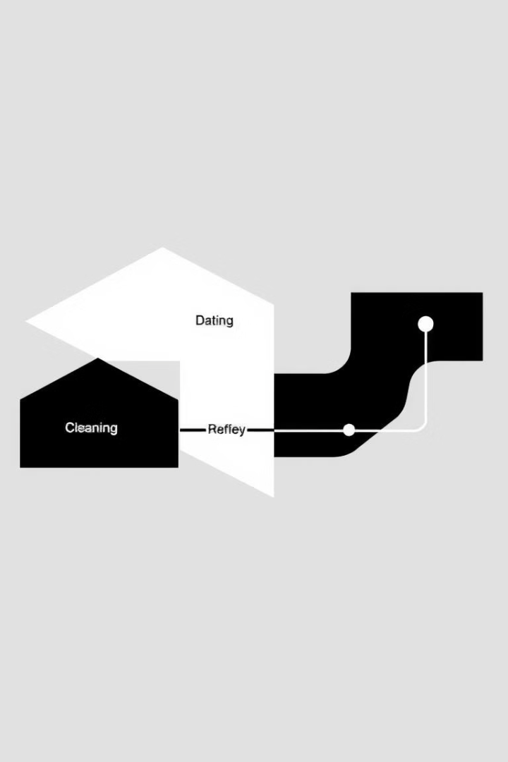
Big Data Pipeline for E-Commerce Recommendations
(SHOP SMART)
This project explores the implementation of a Big Data management pipeline to process and analyze large-scale e-commerce datasets for a recommendation system.
By Naresh.G, Sudherson.G, Saif Jawed

Slide 2
System Architecture
Data Ingestion
Data Cleaning
Recommendation Generation
Web Application
Raw datasets are uploaded to a GCP Cloud Storage bucket and ingested into BigQuery using a GCP Dataflow pipeline or a custom script.
An Airflow DAG processes raw data, handling missing values, removing duplicates, and standardizing data formats.
The web application queries the recommendation data table using BigQuery APIs and displays recommendations to users via an interactive interface.
An Airflow DAG computes recommendations using cosine similarity, extracting user preferences and product features, calculating pairwise cosine similarity, and writing the recommendation data to a BigQuery table.

Slide 3

Data Cleaning Process
1
Step 1: Raw Data Ingestion
2
Step 2: Data Cleaning
3
Step 3: Recommendation Generation
Raw e-commerce datasets are uploaded to a GCP Cloud Storage bucket and ingested into BigQuery.
An Airflow DAG is triggered for cleaning the raw data, handling missing values, removing duplicates, and standardizing data formats.
An Airflow DAG computes recommendations using cosine similarity, extracting user preferences and product features, calculating pairwise cosine similarity, and writing the recommendation data to a BigQuery table.

Slide 4




Recommendation Generation
User Preferences
1
Extracted from the cleaned data.
Product Features
2
Extracted from the cleaned data.
Cosine Similarity Calculation
3
Measures the similarity between user preferences and product features.
Recommendation Data
4
Stored in a BigQuery table.

Slide 5
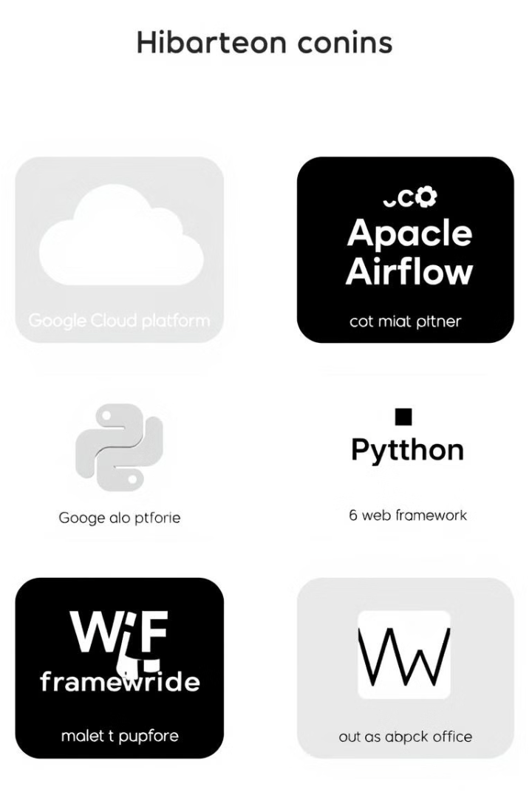




Technologies Used
Google Cloud Platform
Apache Airflow
Cloud Storage, BigQuery, Dataflow.
Orchestrates data pipeline tasks.
Python
Web Framework
Implements cleaning and recommendation algorithms.
Serves the recommendation system to end-users.

Slide 6
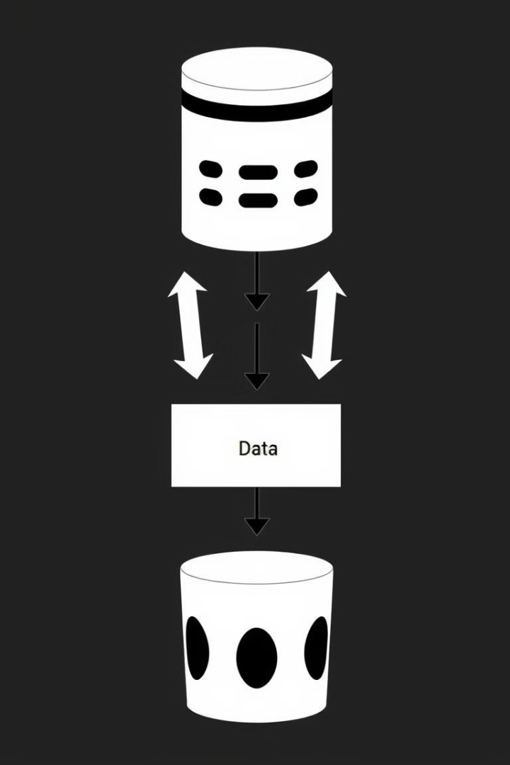
Data Storage Configuration
Cloud Storage
BigQuery Tables
Raw datasets are uploaded to a designated bucket with IAM permissions ensuring secure access.
raw\_data: Stores unprocessed datasets. cleaned\_data: Stores cleaned and preprocessed datasets. recommendation\_data: Stores the output of the recommendation engine.

Slide 7
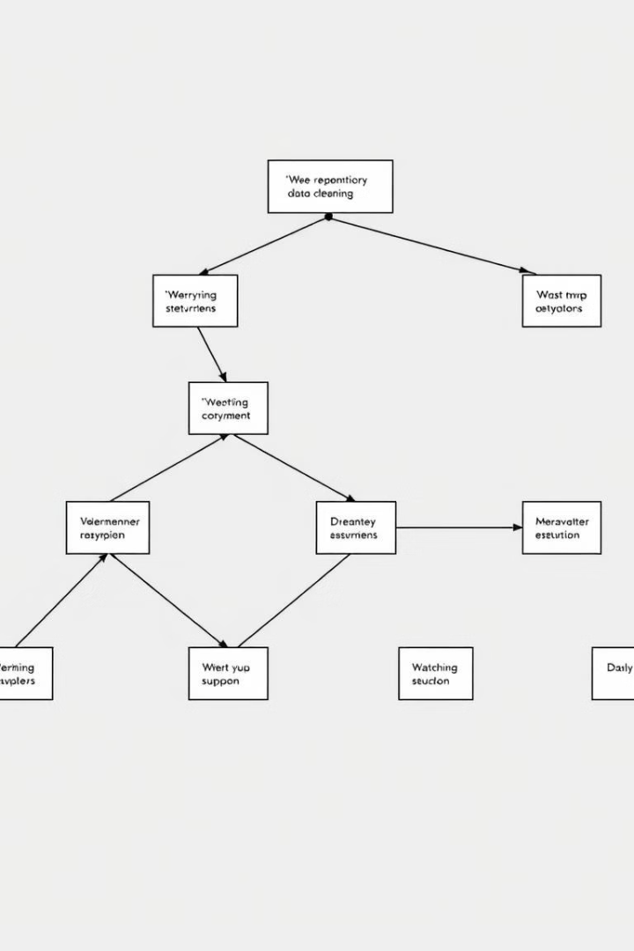


Airflow DAGs
Data Cleaning DAG
Tasks include loading raw data, cleaning, and writing cleaned data to BigQuery.
Recommendation DAG
Tasks include feature extraction, cosine similarity computation, and storing recommendations.

Slide 8
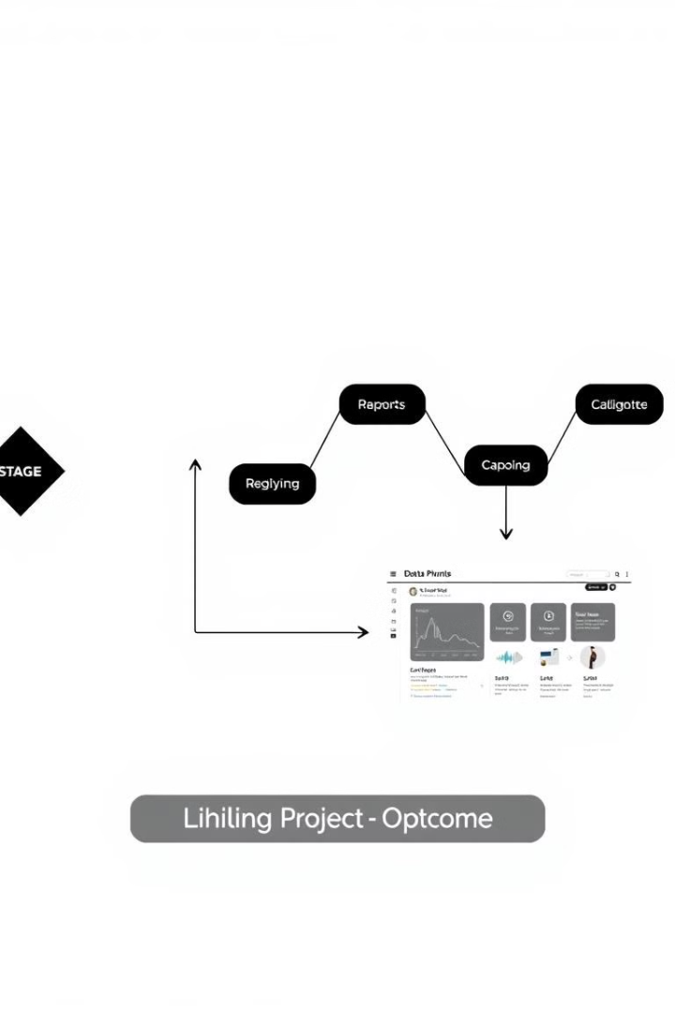
Conclusion
This project demonstrates the implementation of a scalable and efficient big data pipeline for e-commerce recommendation systems. By leveraging cloud technologies and advanced algorithms, the system ensures accurate and real-time recommendations.

